Slide 1
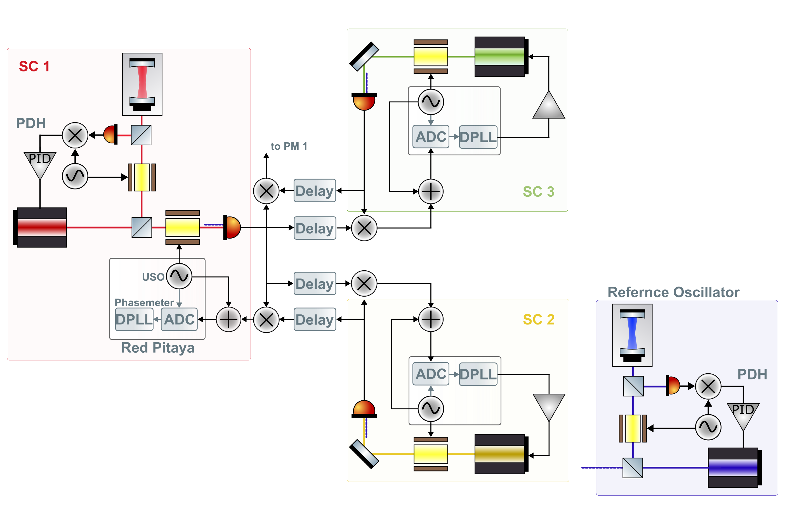

Slide 2
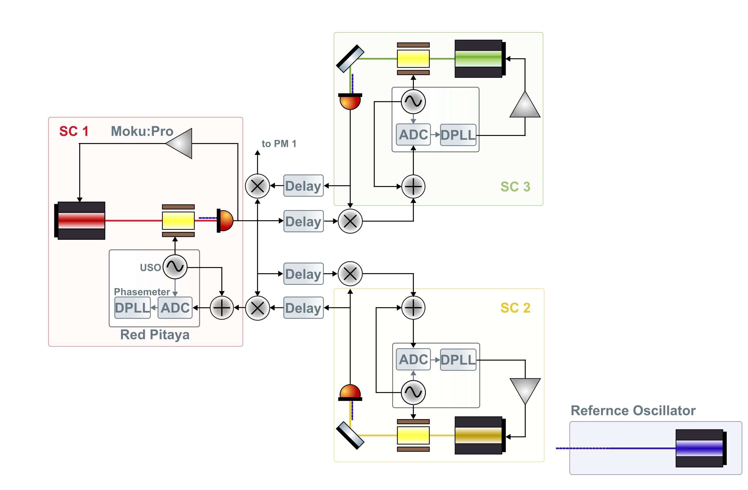

Slide 3
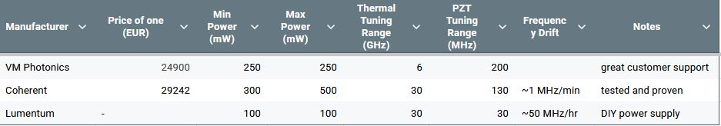
Laser Quotes

Slide 4
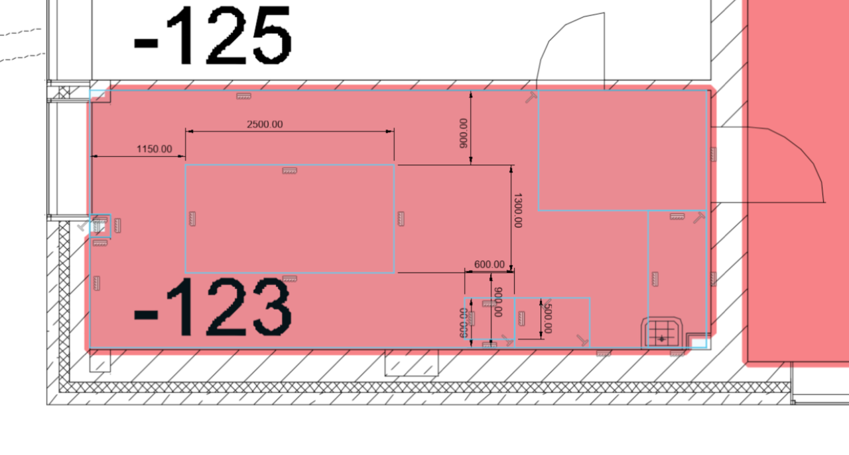
Room Layout
T1220C – Thorlabs Nexus Optical Table, 1.2 m x 2 m x 210 mm (4152 EUR)
PTS603 - Thorlabs Active Legs, 700 mm (3356 EUR)
Where should the vacuum tank go?
T1220C

